Slide 1

PES Institute of Technology and Management
“HOME AUTOMATION USING ARDUINO”
Under the Guidance of
Mr. CHETAN L.S, _{B.E., M.Tech, (PhD).}
Assistant Professor ,Dept of CSE
TEAM
Ms. APOORVA P 4PM11CS012
Ms. ARSHIYA TABASSUM 4PM12CS012
Ms. B.Y SIRI 4PM12CS018
Mr. MOHAMMED SALMAN 4PM12CS045

Slide 2
contents
Abstract
Home automation
Application
Requirements
Hardware specifications
System design
Result
Conclusion

Slide 3
PROBLEM statement
The latest trend in the technologies related to wireless communication has led to the emergence of several engineering designs for human requirements. The creeping interests in the wireless and GSM based projects, we came up with this idea of developing a simpler, cost-effective design to control the on-off home lights via short message service (SMS) and PIR sensor.

Slide 4
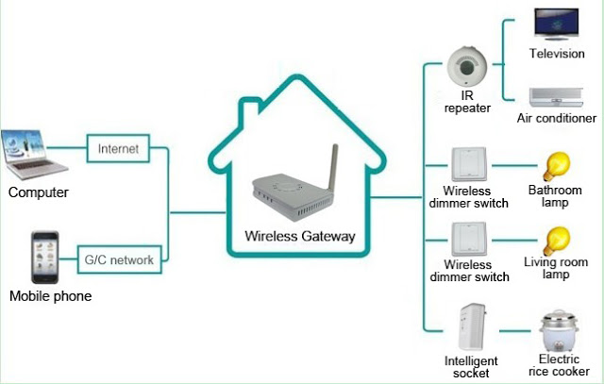
Home automation
Gsm controlled home lightening system

Slide 5
Home automation
Home automation system integrates electrical devices in a house with each other. Refers to the automatic and electronic control of household features, activity, and appliances. Various control systems are utilized in this residential extension of building automation.
The techniques includes control of domestic activities such as home entertainment systems, lighting control system and use of domestic robots.

Slide 6
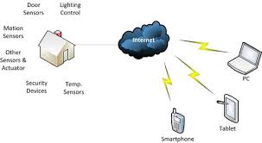
Home automation

Slide 7
Hardware requirements
Arduino Uno Board.
GSM Module .
Relay(8-Switch).
PIR Sensor.

Slide 8
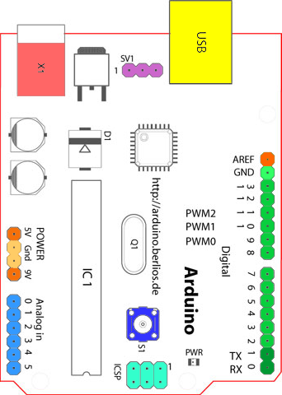
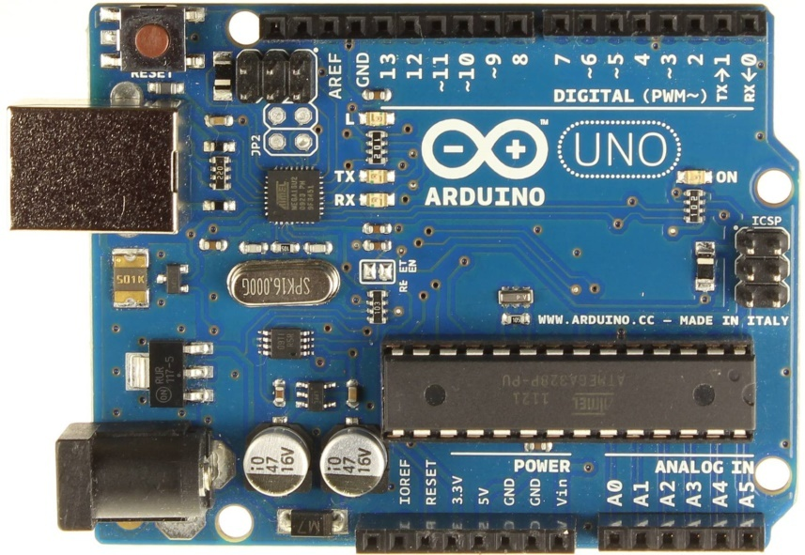
Arduino UNO Board

Slide 9
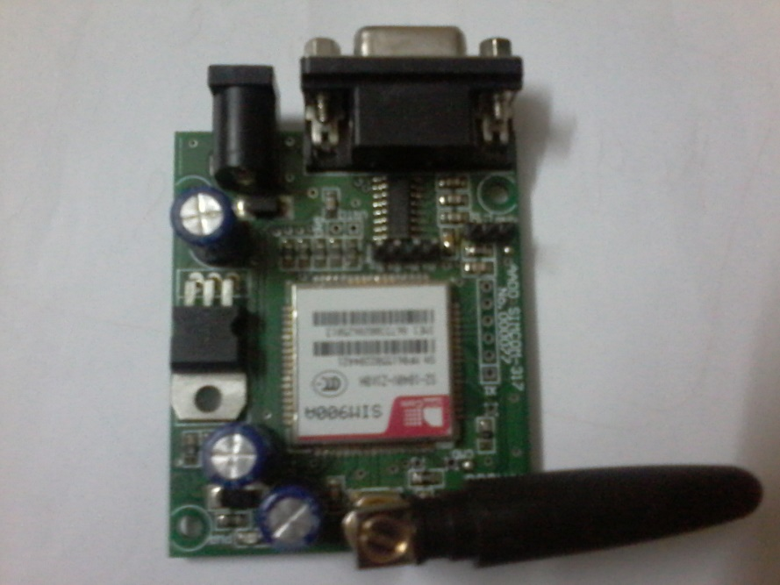
GSM Module

Slide 10
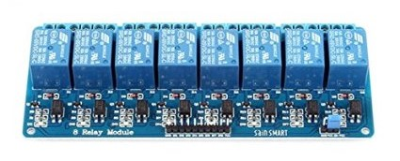
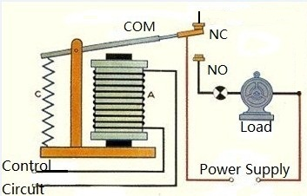
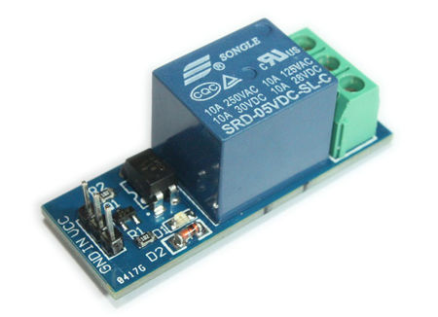
RELAY

Slide 11
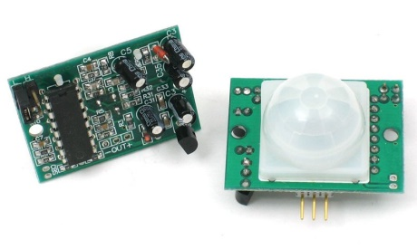
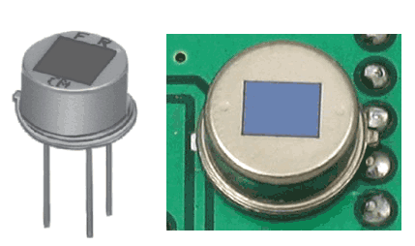
P I R sensors

Slide 12
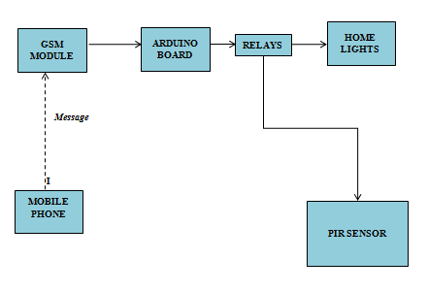
SYSTEM DESIGN

Slide 13
SYSTEM DESIGN
System consists of a Arduino mega board which acts as base for all connections .
It consists of a GSM module in which SIM card is inserted to receive SMS and communicate the received message with other devices like relay. And relays are used to switch the lights on/off.
PIR sensor (Passive Infrared Sensor) used to detect the movement of human beings thereby controlling the home appliances.

Slide 14
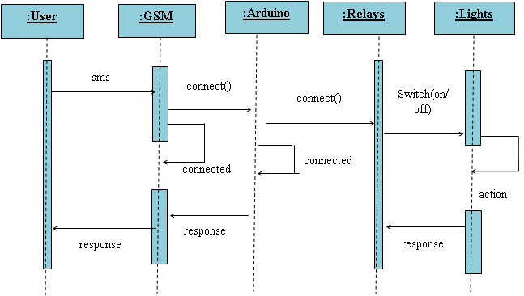
SYSTEM Working
SCENARIO I

Slide 15
Arduino-GSM integration
Arduino GSM shield connects arduino to the internet using the GPRS wireless network ,make /receive voice calls and send/ receive SMS message.
The shield use digital pins 2 and 3 for software serial communication with the GSM. Pin 2 is connected to the TX pin and pin 3 to RX pin.

Slide 16
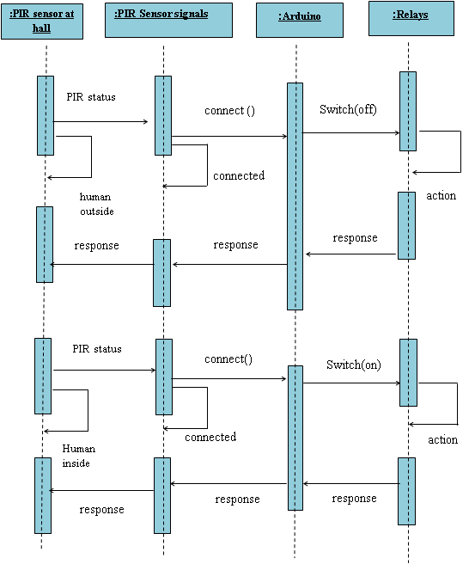
SCENARIO II

Slide 17
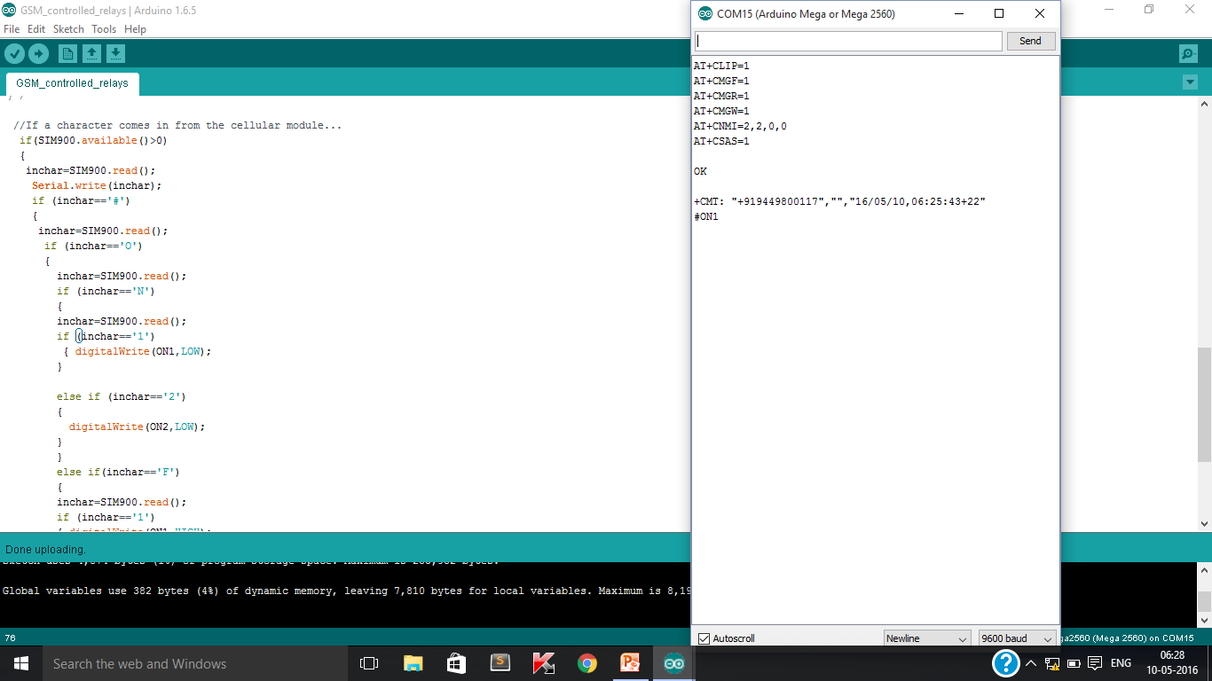
RESULT

Slide 18

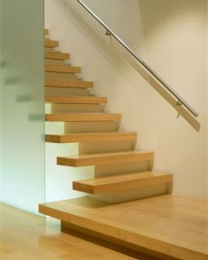
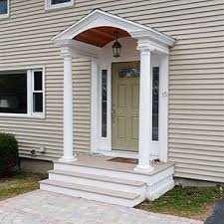
where to have PIR SENSOR
CORIDORS
STER CASES
PORTICO

Slide 19
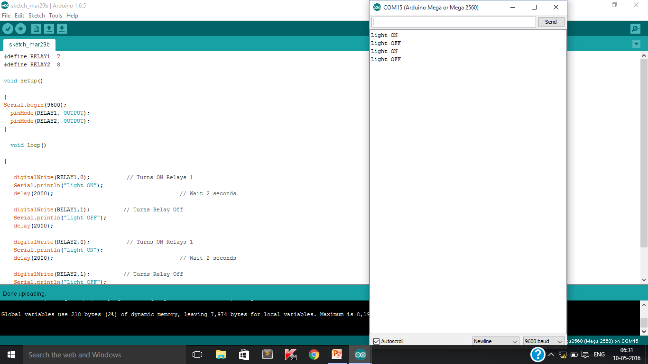

Slide 20
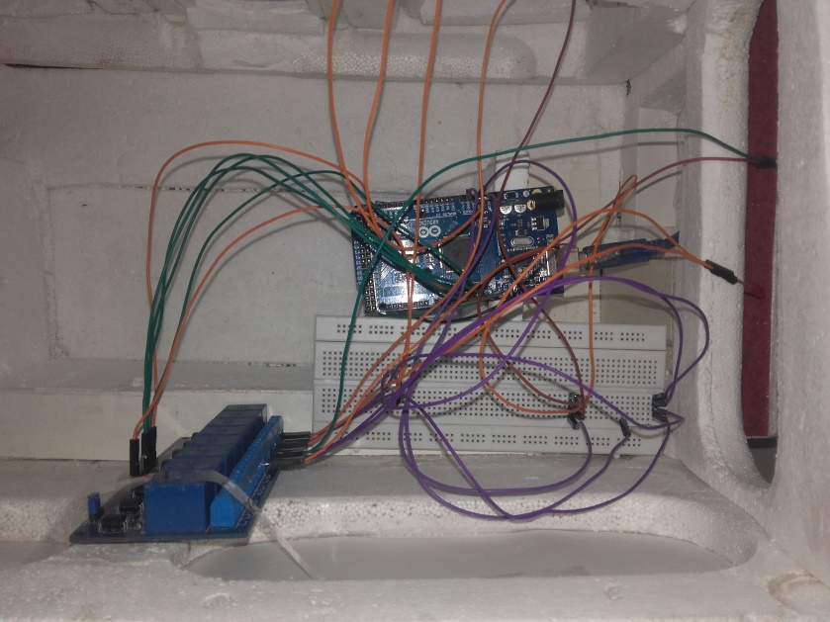
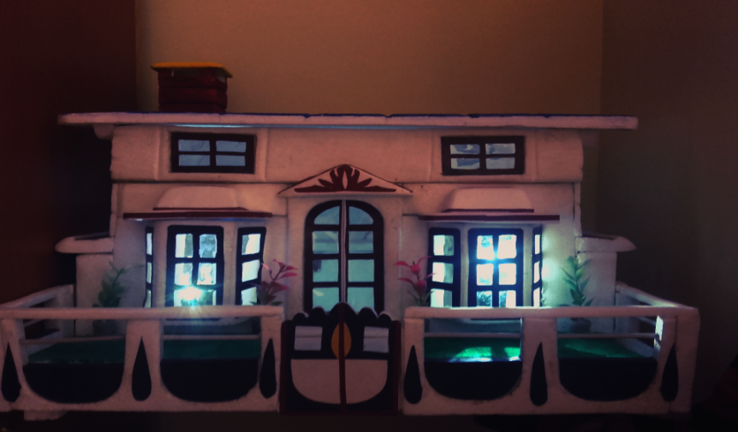
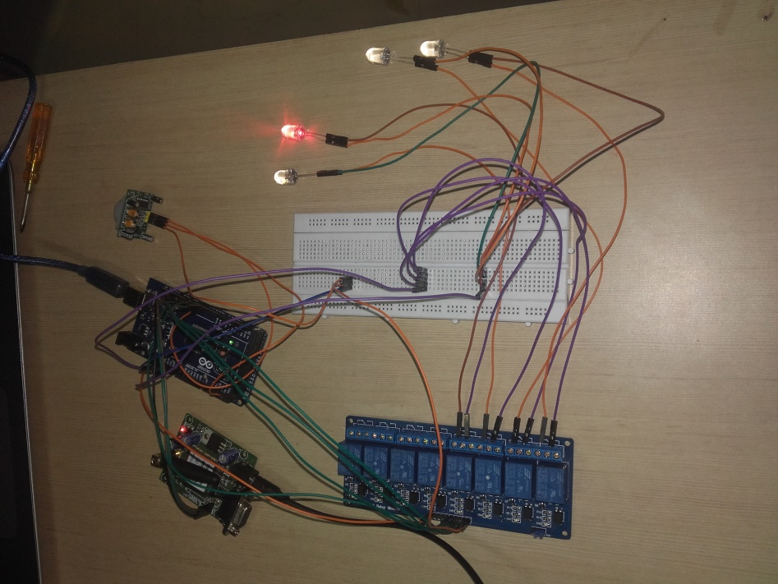
Home automation

Slide 21
Conclusion
The home automation using internet of things has been experimentally proven to work satisfactorily by connecting simple appliances to it and the appliances were successfully controlled remotely through network. This will help the user to switch on and switch off the home appliances anytime from anywhere using remote device.

Slide 22
FUTURE SCOPE
Home automation is automation of the home or household activity. Home activity may include centralized control of lighting, appliances and security locks of the gates to provide improved convenience, comfort, energy efficiency and security. Home automation system integrates electrical devices in a house with each other.

